Slide 1

GUI Applications using Java programming language
Object Oriented Programming
Prepared by: Mehak Usmani

Slide 2
Content
Intro to GUI & JavaFX
JavaFX Architecture
Requirements
Application Structure
Developing a first UI based application

Slide 3
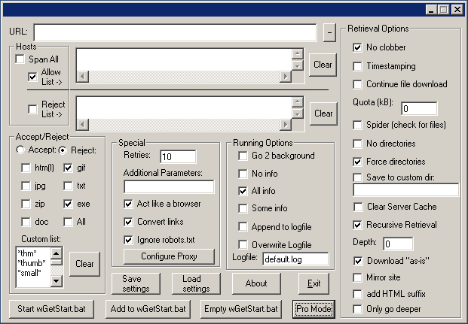
Intro to GUI & javaFX
Notes:
The graphical user interface is a type of user interface that allows users to interact with machines through graphical icons and visual indicators instead of text-based user interfaces which needs commands to operate

Slide 4
Intro to GUI & javaFX
JavaFX is a set of graphics and media packages that enables developers to design, create, test, debug, and deploy rich client applications that operate consistently across diverse platforms.
The applications developed using JavaFX can run on various devices such as Desktop Computers, Mobile Phones, TVs, Tablets, etc.
To develop GUI Applications using Java programming language, the programmers rely on libraries such as Advanced Windowing Tool kit and Swings.
After the advent of JavaFX, Java programmers can now develop GUI applications effectively with rich content.

Slide 5
Features
Platform independent
Built-in UI controls
Smooth graphics
Cascading Style Sheets (CSS)
FXML
Scene Builder

Slide 6
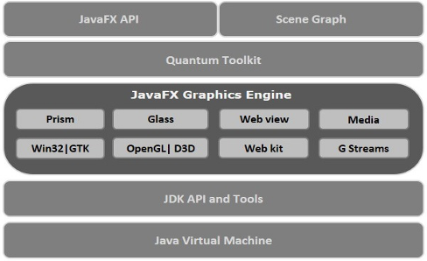
JavaFX Architecture
Notes:
Prism is a high performance hardware–accelerated graphical pipelinethat is used to render the graphics in JavaFX.
GWT connects the JavaFX Platform to the Native Operating System.
Quantum ties Prism and GWT together and makes them available to JavaFX.
WebView is the component of JavaFX which is used to process HTML content

Slide 7
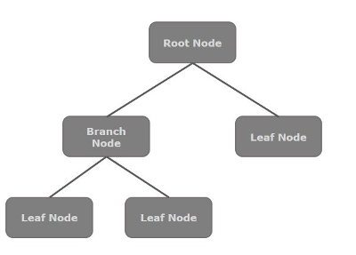
Scene Graph

Slide 8
Requirements
From Java8 onwards, the JDK (Java Development Kit) includes JavaFX library in it. Therefore, to run JavaFX applications, you simply need to install Java8 or later version in your system.
An IDE

Slide 9
Packages
The important packages of this JavaFX are
javafx.animation
javafx.application .
javafx.css
javafx.event
javafx.geometry
javafx.stage
javafx.scene

Slide 10
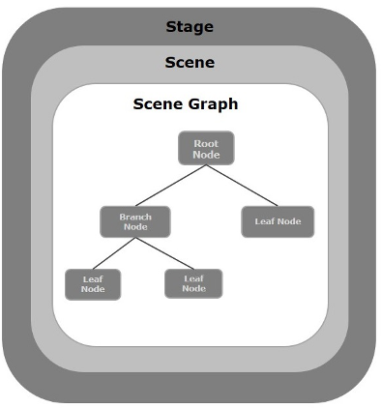
Application Structure

Slide 11
Application Structure
Stage
A stage (a window) contains all the objects of a JavaFX application.
Scene
A scene represents the physical contents of a JavaFX application. It contains all the contents of a scene graph.
Scene Graph
A scene graph is a tree-like data structure (hierarchical) representing the contents of a scene.
Geometrical (Graphical) objects (2D and 3D) such as − Circle, Rectangle, Polygon, etc.
UI Controls such as − Button, Checkbox, Choice Box, Text Area, etc.
Containers (Layout Panes) such as Border Pane, Grid Pane, Flow Pane, etc.
Media elements such as Audio, Video and Image Objects.

Slide 12
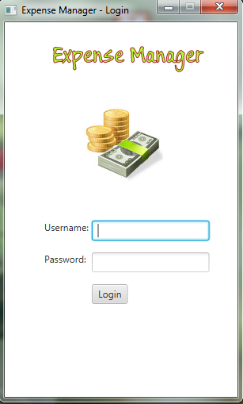
First GUI project
Lets start development in JavaFx for a demo project called Expense Manager.

Slide 13
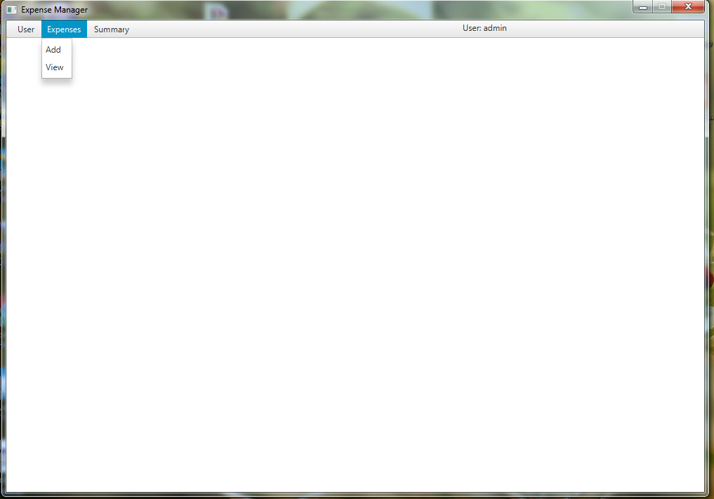
Home Stage with menus

Slide 14
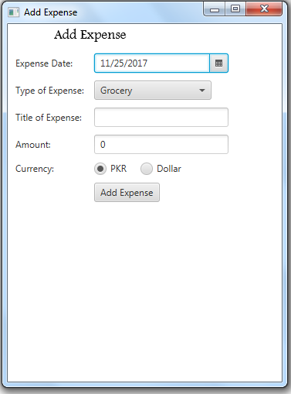
Add record in File using data from JavaFx controls

Slide 15
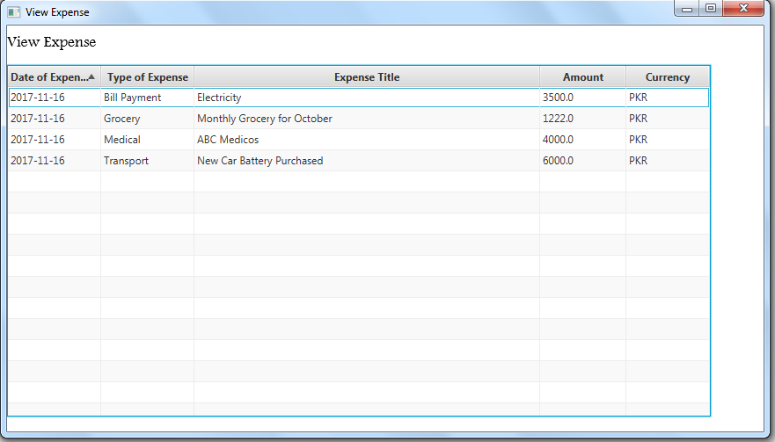
Read data from file and display in TableView control of JavaFx

Slide 16
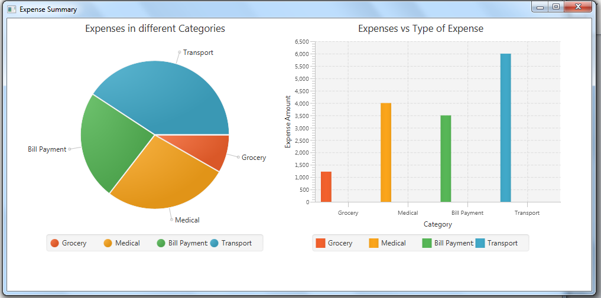
Read data from file and draw graphs

Slide 17
Login Screen Design
Stage, Root, Scene, Scene Graph, Image, Text, Lable, TextField.
Events
Login Code
Data transfer between screens,
Menu
Dialogue Box
Add Expense Screen design with Layouts
Add Expense Screen; data write in file.
View Expense Screen; data read in application using TableView.
Graphs (Bar, Pie)

